Slide 1
INVESTOR BRIEF
TensorVerse.ai
AI systems for digital twins, LLM quantum fusion, accessible learning, and healthcare operations.
PRIMARY
PRIMARY
VALIDATION
Quantinuum
Potara
NVIDIA Inception
Digital twin and simulation system.
LLM quantum fusion workflow engine.
NVIDIA Inception member; pursuing GCP cloud credits.
NVIDIA Inception member â€¢ GCP credit target
01

Slide 2
TENSORVERSE.AI
The problem
AI is powerful, but most tools are disconnected from real workflows.
Generic chat does not preserve enough domain context.
Digital twin and simulation tools remain expensive and specialized.
Creative/model workflows lack strong fusion and evaluation layers.
Classrooms need accessible support without replacing teachers.
Healthcare operations still depend on fragmented EDI, EVV, staffing, and onboarding workflows.
NVIDIA Inception member â€¢ GCP credit target
02

Slide 3
TENSORVERSE.AI
The TensorVerse thesis
Reusable AI infrastructure should move across domains.
INFRASTRUCTURE
PLATFORMS
PROOF
Shared AI layer
Primary systems
Applied products
Memory, retrieval, model orchestration, multimodal generation, synthetic data, evaluation, and human review.
Quantinuum handles simulation and digital twins. Potara handles LLM quantum fusion and workflow generation.
Code_Y and Swoosh Care show the same infrastructure moving into education and healthcare operations.
NVIDIA Inception member â€¢ GCP credit target
03

Slide 4
TENSORVERSE.AI
Quantinuum
Digital twin and simulation system.
AI NPC inference
World-state memory + AI NPCs
simulation agents
real-world/digital feedback
Quantinuum is the long-term platform bet: simulated environments where context persists, agents act, and consequences can be evaluated.
prediction-oriented interaction layers
NVIDIA Inception member â€¢ GCP credit target
04

Slide 5
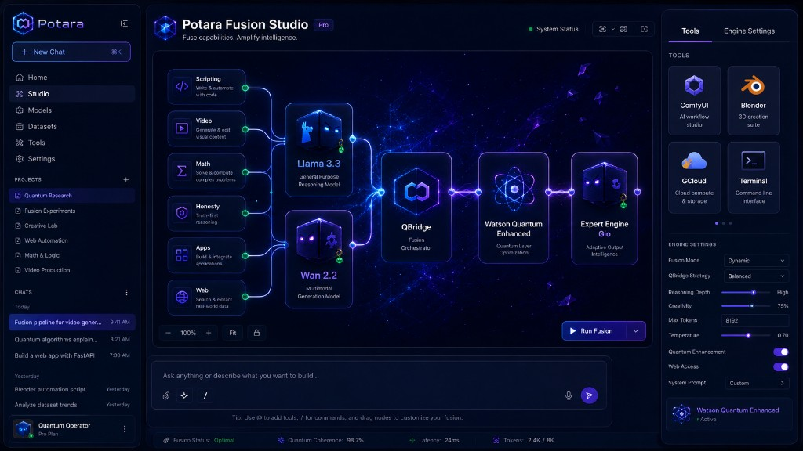
TENSORVERSE.AI
Potara
LLM quantum fusion workflow engine.
ENGINE
NEAR-TERM
Fusion workflows
Demo velocity
Combine LLMs, concepts, media, and structured reasoning outputs through orchestration, scoring, and multimodal generation.
Potara can produce investor-visible workflows faster than the full Quantinuum platform while becoming a reusable layer.
NVIDIA Inception member â€¢ GCP credit target
05

Slide 6
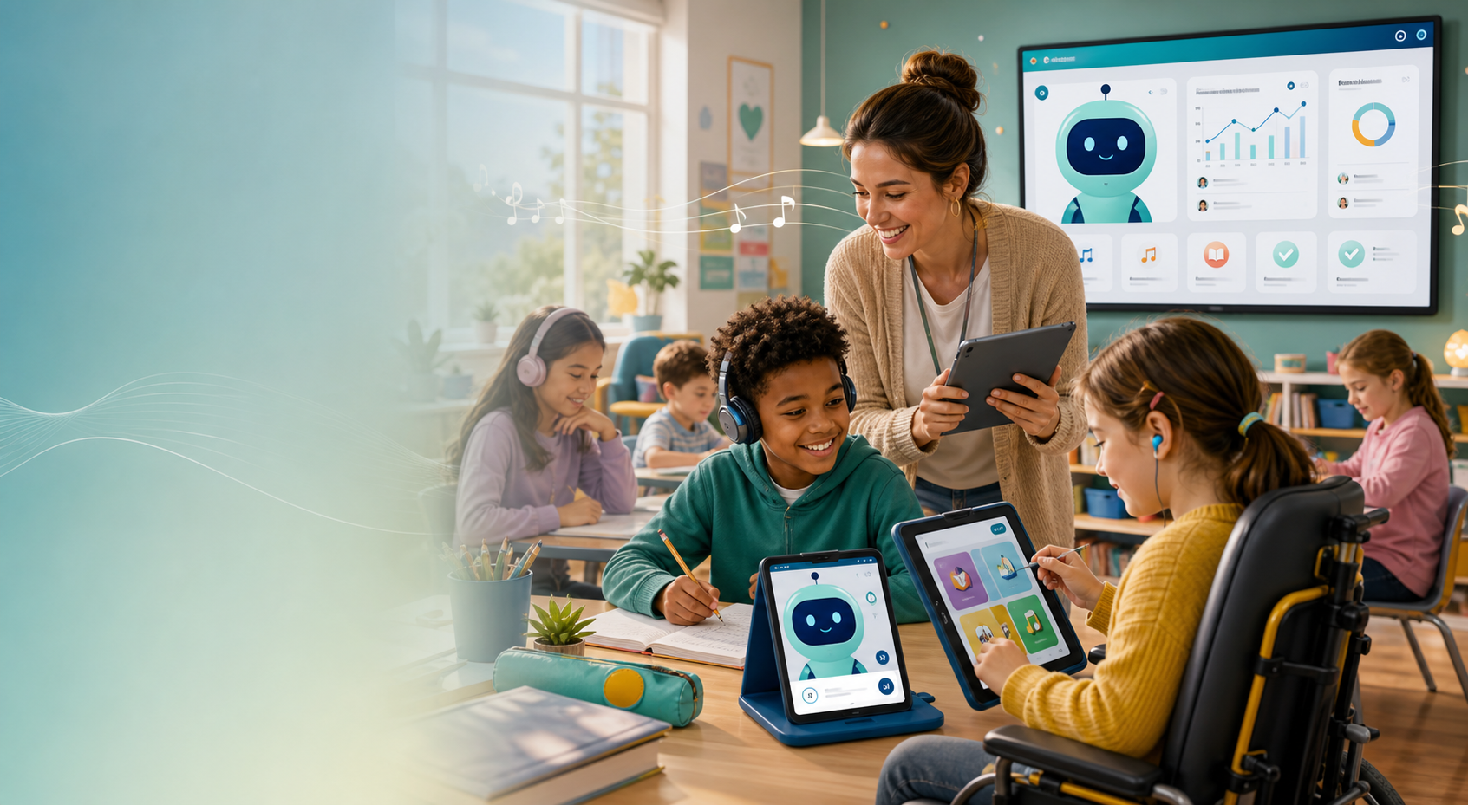
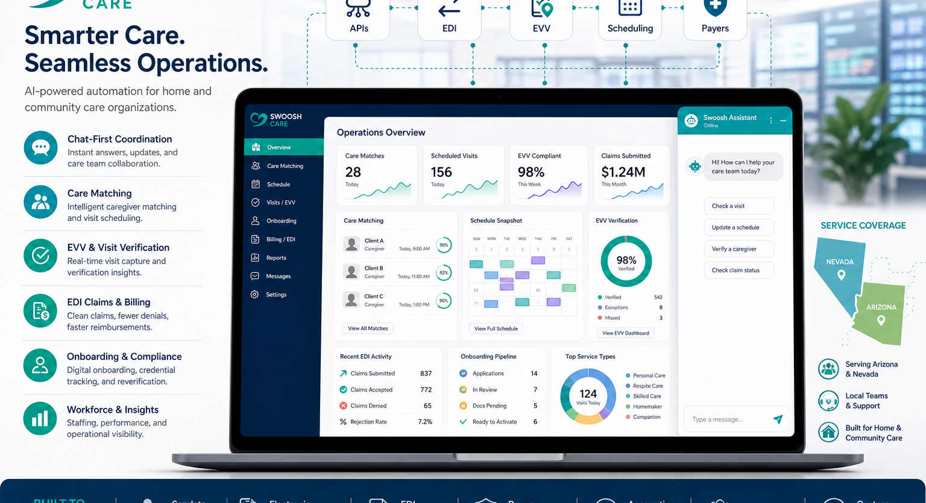
TENSORVERSE.AI
Applied products
Vertical proof for the shared TensorVerse infrastructure.
BOUNDARY
Human review
Adults remain responsible. No claims of replacing teachers, clinicians, therapists, or care plans.
CODE_Y CLASSROOM
SWOOSH CARE
Teacher-led AI aide
Healthcare operations
Homework, grading, voice, accessibility.
EVV, EDI, Sandata workflows.
NVIDIA Inception member â€¢ GCP credit target
06

Slide 7
TENSORVERSE.AI
Market entry
Use applied products to prove infrastructure while primary systems mature.
1
2
3
4
Potara demos
Code_Y pilots
Swoosh Care
Quantinuum
Fastest path to investor-visible fusion workflows.
Accessible classroom and teacher-support wedge.
Healthcare operations automation in Nevada and Arizona.
Private digital twin and simulation demos.
NVIDIA Inception member â€¢ GCP credit target
07

Slide 8
TENSORVERSE.AI
30 / 60 / 90 day roadmap
GPU-backed demos convert story into evidence.
30 DAYS
60 DAYS
90 DAYS
Prototype proof
GPU demos
Investor room
Clean product pages, private demos, Potara fusion ranking, Quantinuum world-state memory.
GPU-backed endpoints, LoRA/QLoRA experiments, multimodal evaluation, investor demo video.
Private demo room, pilot conversations, measured usage, expanded GCP credit request.
NVIDIA Inception member â€¢ GCP credit target
08

Slide 9
TENSORVERSE.AI
Why NVIDIA / Why GCP
Inception status plus concrete GPU milestones.
NVIDIA
GCP
EXPANSION
Inception member
$25k-$50k pilot ask
$100k+ follow-on
Developer resources, partner cloud-credit pathways, and potential investor exposure after Capital Connect eligibility and eligibility review.
TensorVerse already uses GCP-backed deployment workflows. Credits target Vertex AI, Cloud Run/GKE, Storage, Vector Search, and evaluation logs.
Request expansion after measurable GPU usage, demo milestones, and investor/pilot progress.
NVIDIA Inception member â€¢ GCP credit target
09

Slide 10
TENSORVERSE.AI
The ask
Investors, cloud credits, and GPU-backed demo support.
Investor feedback and introductions for AI infrastructure and simulation investors.
GCP cloud credits for Quantinuum and Potara GPU-backed development.
NVIDIA Inception partner pathways and official profile completion.
Pilot partners for Code_Y Classroom and Swoosh Care.
Business email required next: use an active @tensorverse.ai mailbox.
www.tensorverse.ai/investors â€¢ www.tensorverse.ai/code_y â€¢ swoosh.care
NVIDIA Inception member â€¢ GCP credit target
10

